Slide 1
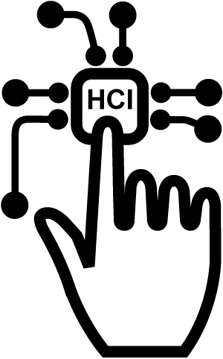

HCI NEWS ITEM PRESENTATION
HOST
Emmanuel Odonkor Teye-Kofi

Slide 2

RESEARCH ARTICLE
What Does It Really Mean to Delight Users?
Karah Salaets
Senior Design Researcher at LiquidHub

Slide 3




INTRODUCTION
Content of presentation
Relation TO
COURSE CONTENT
Relevance
CONCLUSION

Slide 4
INTRODUCTION (1)
What Does It Really Mean to Delight Users?
User Experience as a field
It’s gaining industry awareness and acceptance across domains.
What is Delight?
This should be the focus of UX designs.
Identifying delight in Context
NEXT SLIDE
Other terminologies sparks confusion and debates.
She defines delight as the, “Act of guiding designs”.

Slide 5
INTRODUCTION (2)
Identifying Delight in Context
STEP 1
STEP 2
Analyze Comparable Experiences
STEP 3
Design to Delight
Identify Key Moments or Interactions that generate anxiety or confusion.
Feel Prepared
Competent
Confident

Slide 6
HCI (COURSE CONTENTS)
RELATION TO COURSE CONTENT
NEWS ITEM ARTICLE
User-Centered Approach
( Process of IxD)
Users are of high Importance
Looking at Existing Tasks
Step One: Identify Key Moments or Interactions

Slide 7
RELEVANCE OF THE NEWS ITEM
Re-iterates the benefits of looking at user’s existing tasks
Highlights a key feature of a good design

Slide 8
CONCLUSION
“Assess clients’ understanding of and expectations for what delight means.”
By: Karah Salaets

Slide 9


THANK YOU
Retrieved from https://www.uxmatters.com/mt/archives/2018/08/what-does-it-really-mean-to-delight-users.php

